Slide 1
Empowering African Youth with Coding Skills
Training for SAP Skilled Volunteers
AN INITIATIVE BY

Slide 2
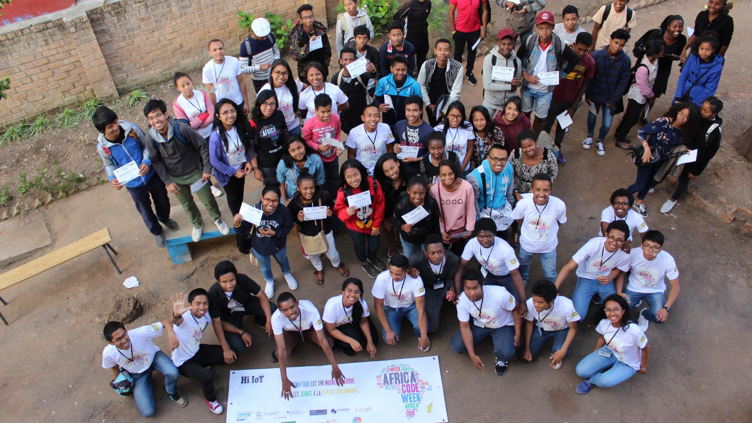
Item | Activity(s) | Time
Introduction to ACW | - Introduction to ACW - Purpose of this TTT session | 15 minutes
Computational Thinking | - Introduction to the concepts of Computational Thinking - Concepts & examples (group participation) - 2 group activities | 45 minutes
Break |  | 10 minutes
Scratch | - Scratch basic & advanced exercises | 100 minutes
Session Wrap-up | - Skimming through additional resources available - Q&As - Wrap-up | 10 minutes
 | TOTAL: | 3h00
agenda

Slide 3
ACW creates opportunities for young Africans to learn coding skills for free
…and for teachers to be trained on digital learning curricula across the continent.
3.85 M youth and 39,000 teachers participated in 2019.
welcome to Africa’s largest digital literacy initiative

Slide 4
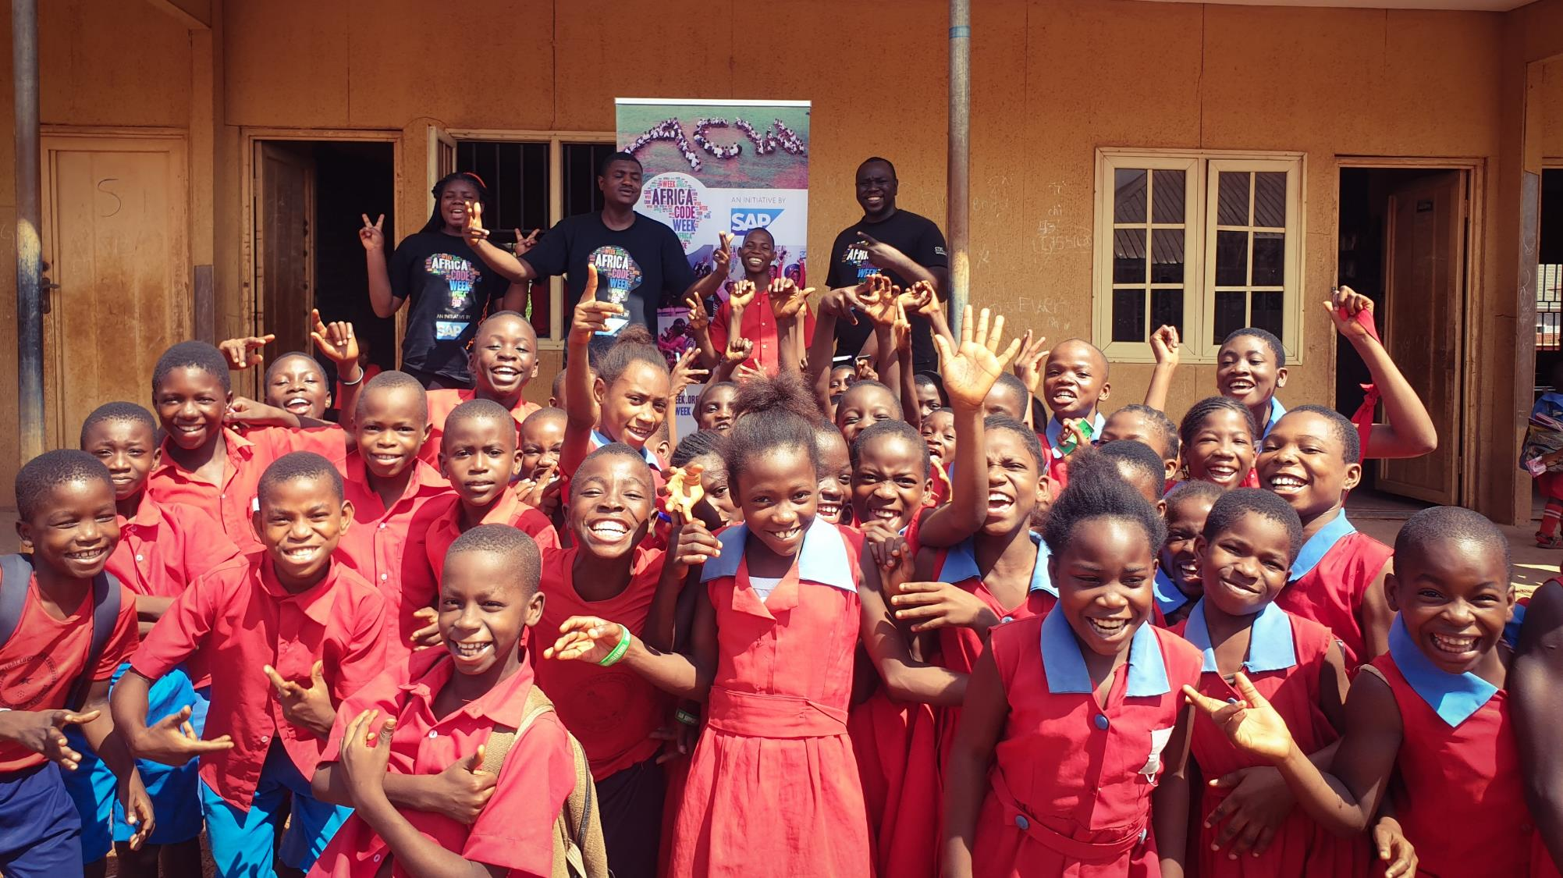
We Support UN SDGs
As Africa’s largest digital literacy initiative, Africa Code Week empowers youth across 54 countries with 21st century skills:
“It takes an empowered village to raise a child in the digital age”
ACW builds sustainable teaching capacity at the community level.
"The Power of Together"
ACW fosters Public-Private Partnerships to accelerate the adoption of coding skills into school curricula.
“No child left behind”
The new virtual ACW is on a mission to deepen impact and reach the unreached.

Slide 5
Major International Awards!
Philanthropist of the Year, Community Foundation for Ireland
C4F Award, Davos World Communications Forum
ACW cited as example of a successful multi-stakeholder initiative in ITU’s Digital Skills Toolkit
ACW launched
2015
2017
2018
a continent-wide success
2016
2017
2019
UNESCO YouthMobile and Google join as key partners
Over 1.8 M youth engaged!
87% of ACW 2019 Survey Respondents feel that the initiative is influential in advancing the adoption of coding into national curricula.

Slide 6
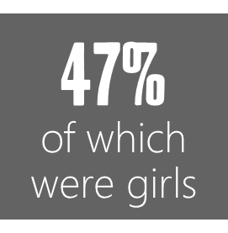
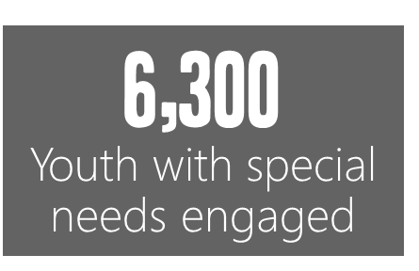
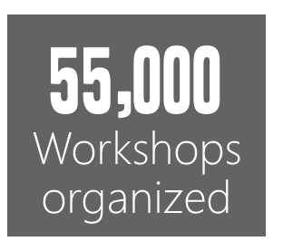
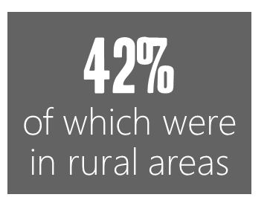
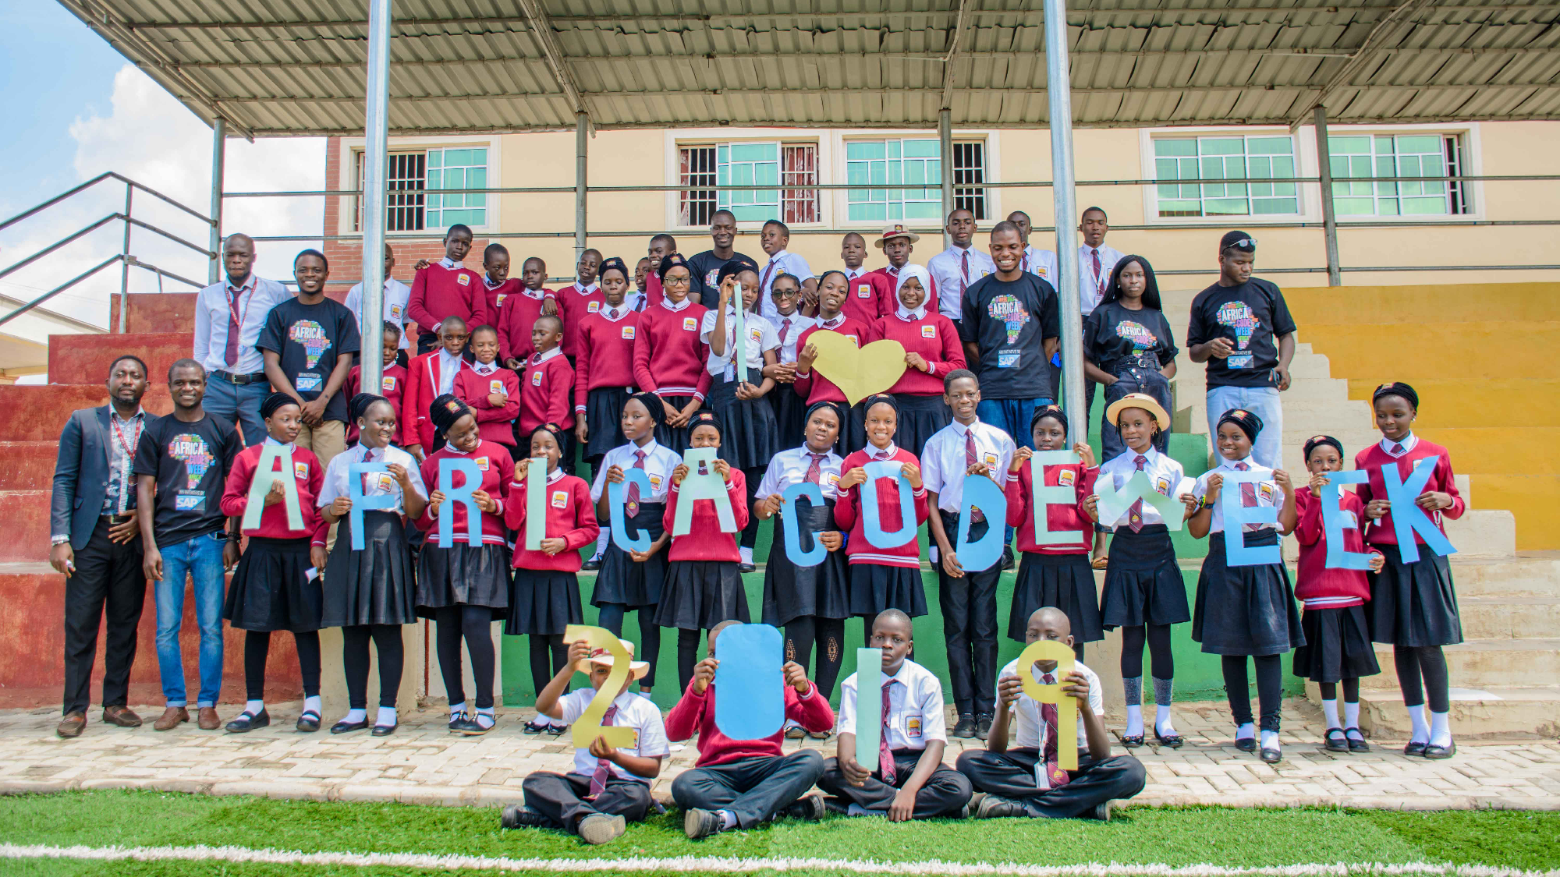
Changing lives...
#ACW2019

Slide 7
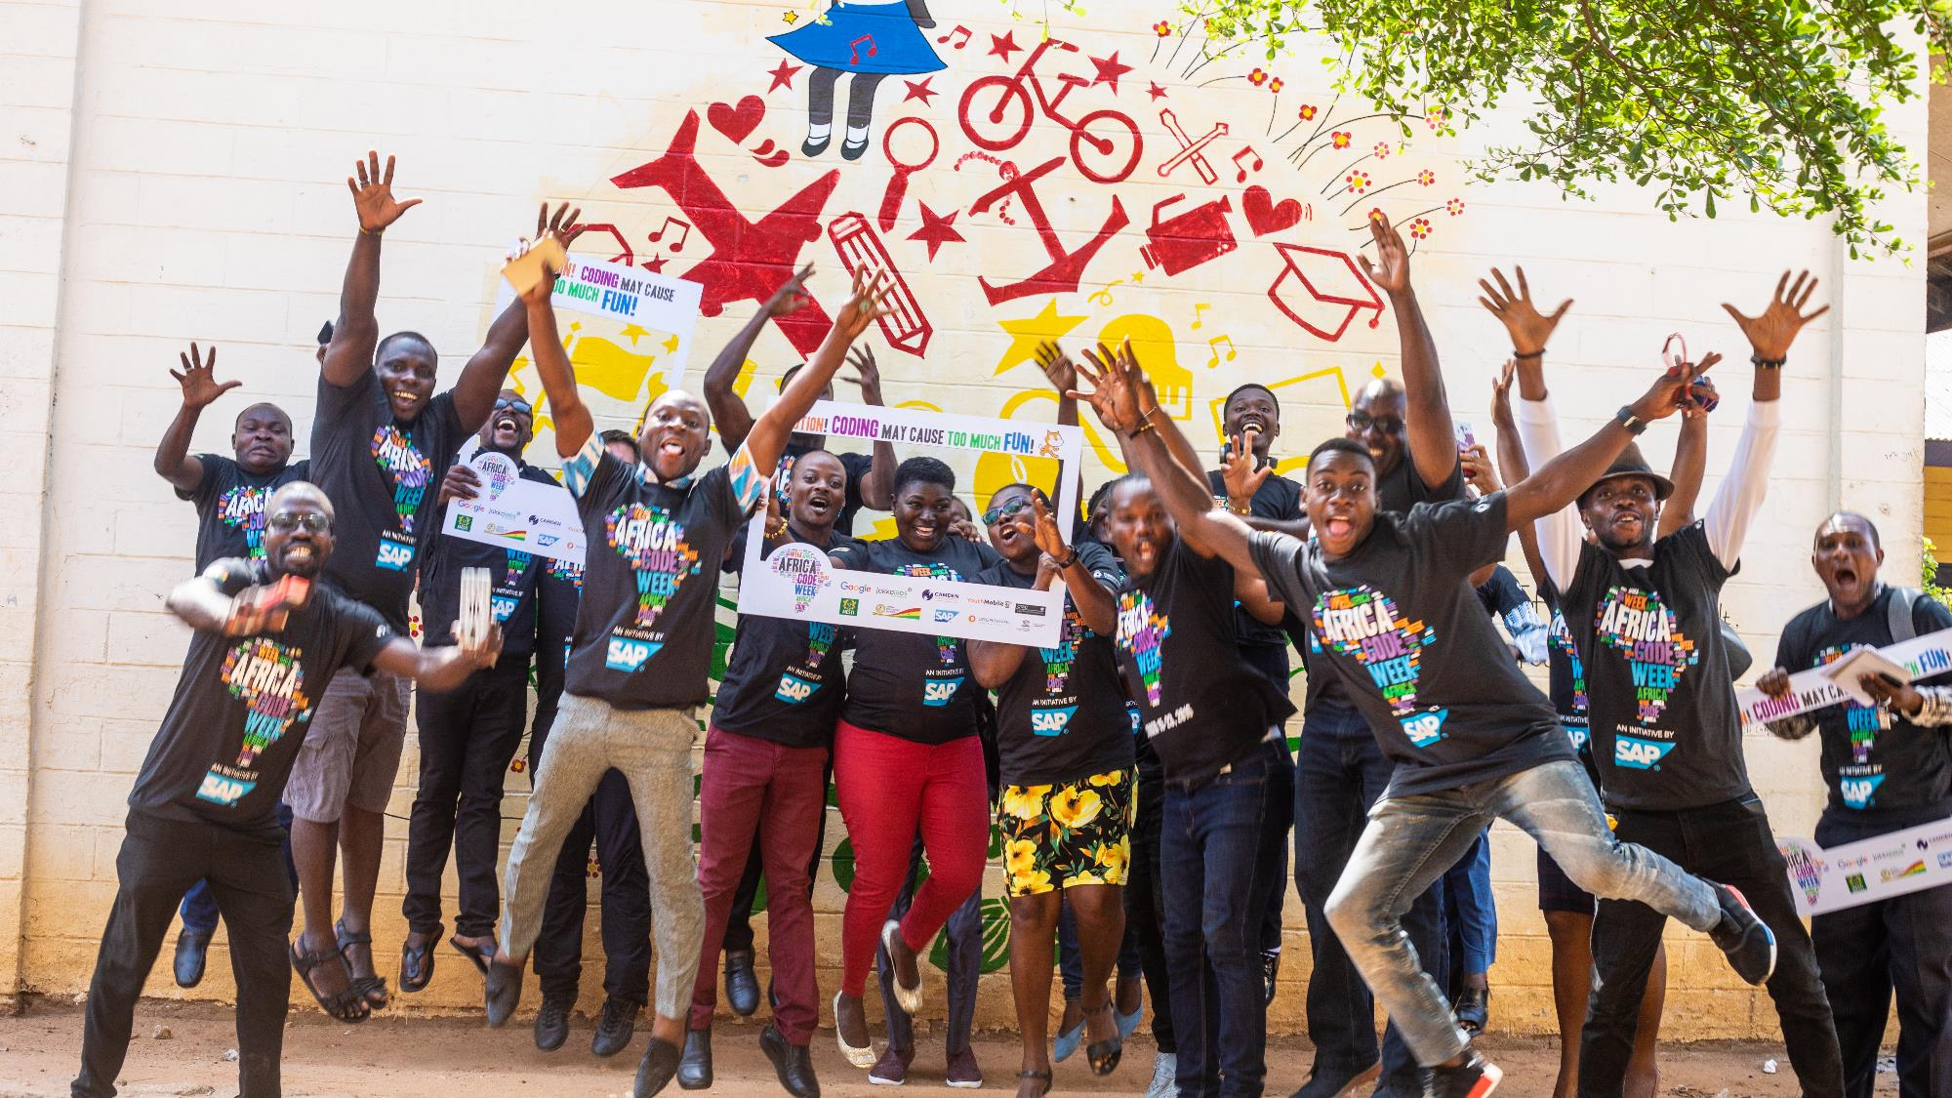
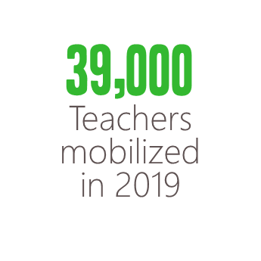
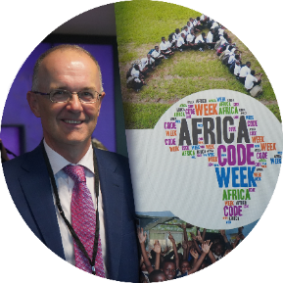
39,000
Teachers mobilized in 2019
enabling teachers like never before
Adequately preparing teachers and students for the future of work is almost upon us: we must continue to focus our collective efforts on capacity building in order to drive long-term impact.”
MD of SAP Labs Ireland & President of the SAP CSR EMEA Governance Committee.

Slide 8
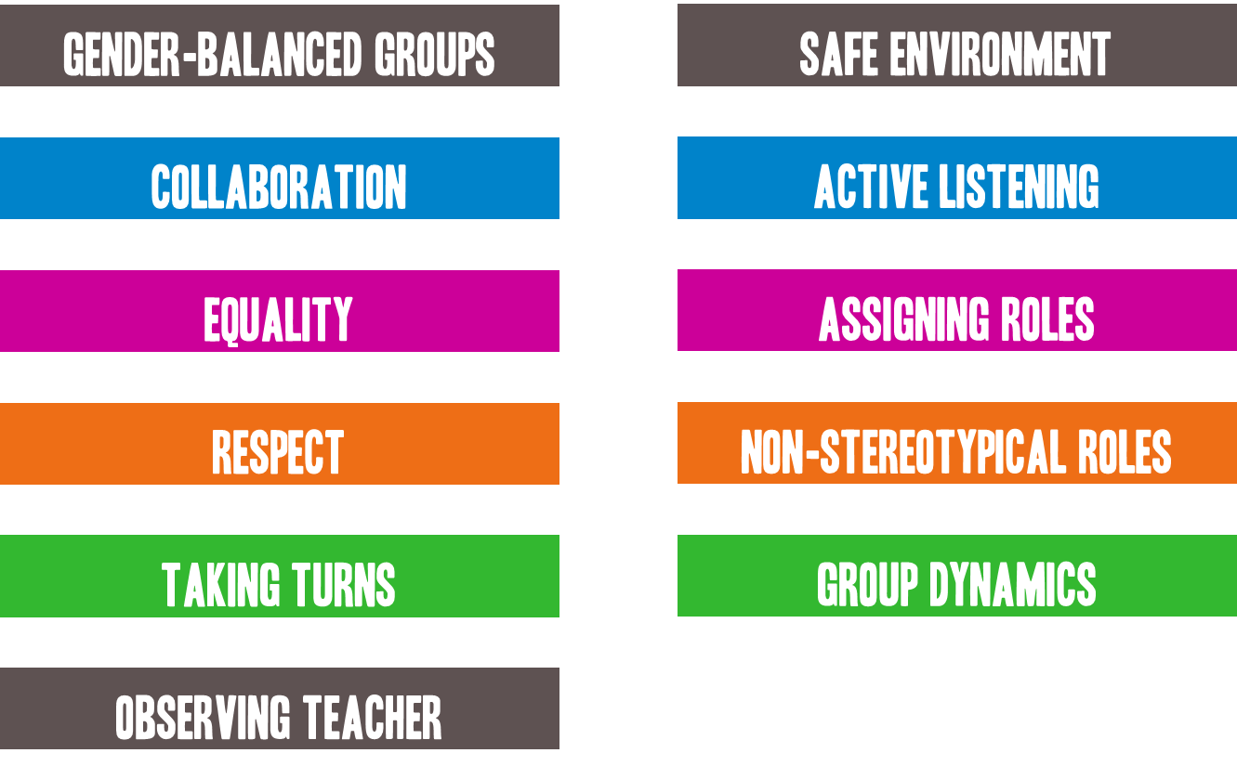
Classroom guidelines
Gender-balanced Groups
Safe environment
Collaboration
Active listening
Equality
assigning roles
Respect
Non-stereotypical Roles
Taking turns
Group Dynamics
Suggestions made by the EQUALS Skills Coalition
Observing Teacher

Slide 9
2-Step Training Session
3-step
TRAINING SESSION
Computational thinking
Let’s Practice with Scratch!
21st CENTURY LEARNING DESIGN

Slide 10
1. COMPUTATIONAL THINKING
AN INITIATIVE BY

Slide 11
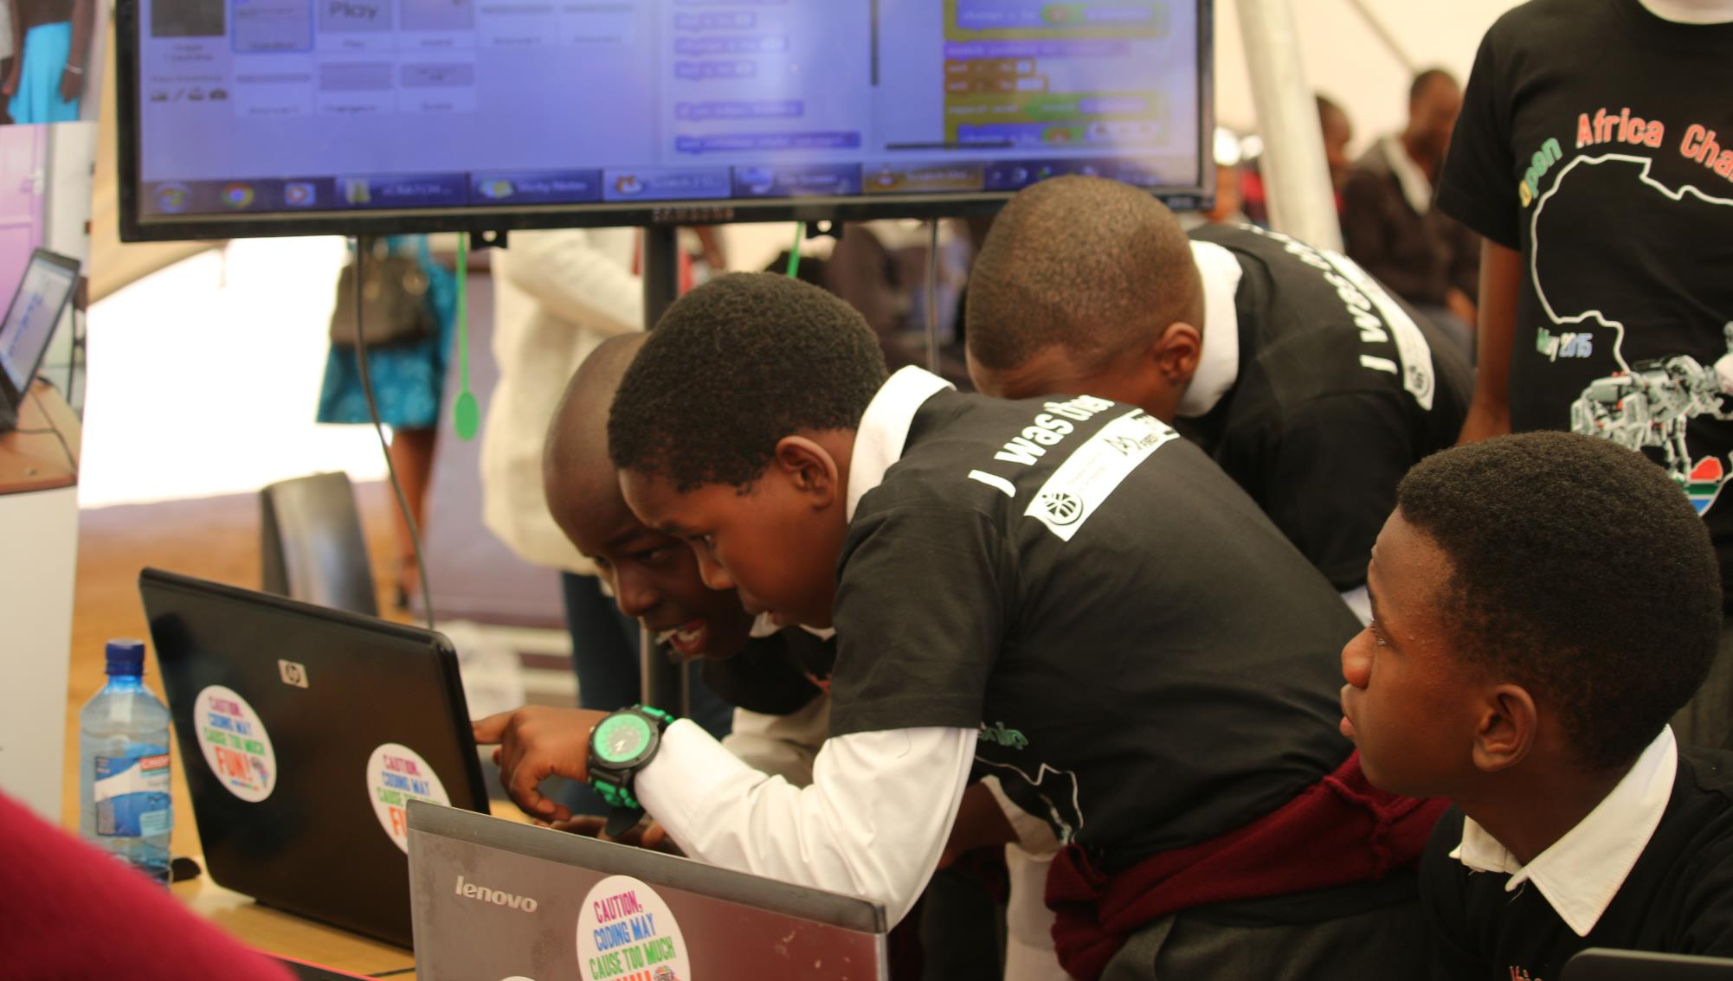
computational thinking is...
The ability to communicate your thoughts in a structured and logical way. This type of thought process is like the step by step instructions that are coded into a computer. It is also the process of thinking up and then solving problems in a methodical way that could be replicated by a machine.
The thought processes involved in formulating a problem and expressing its solution(s) in such a way that a computer—human or machine—can effectively carry out.
Solving problems efficiently, logically and creatively!

Slide 12
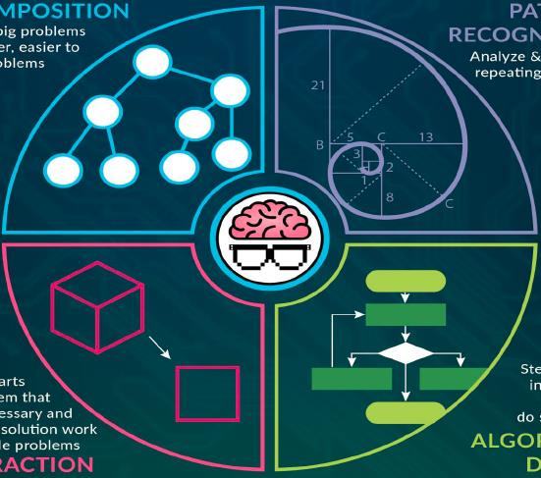
Breaking big problems into smaller ones that are much easier to manage.
Analyze & look for a repeating sequence.
Decomposition
ABSTRACTION
Pattern recognition
ALGORITHM DESIGN
Remove parts of a problem that are unnecessary and make one solution work for multiple problems.
Step-by-step instructions on how to do something.

Slide 13
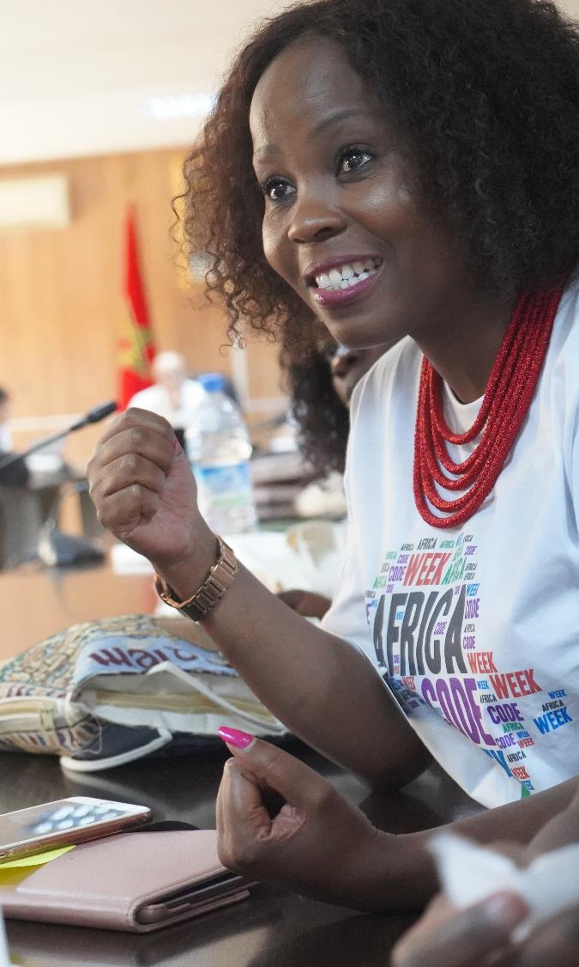
Decomposition
Breaking something into smaller parts
Learners are invited into problem-solving scenarios.
Teachers share the complex, multi-step problem and facilitate conversations that help learners break it down.
For instance:
You want to go to the grocery store.
Break down the task into smaller parts.
Which shop/market will you go to?
What items will you buy?
What time are you planning to go?
How will you get to the grocery shop?
How much will you need?

Slide 14
Breaking big problems into smaller ones that are much easier to manage.
Analyze & look for a repeating sequence.
Decomposition
ABSTRACTION
Pattern recognition
ALGORITHM DESIGN
Remove parts of a problem that are unnecessary and make one solution work for multiple problems.
Step-by-step instructions on how to do something.

Slide 15
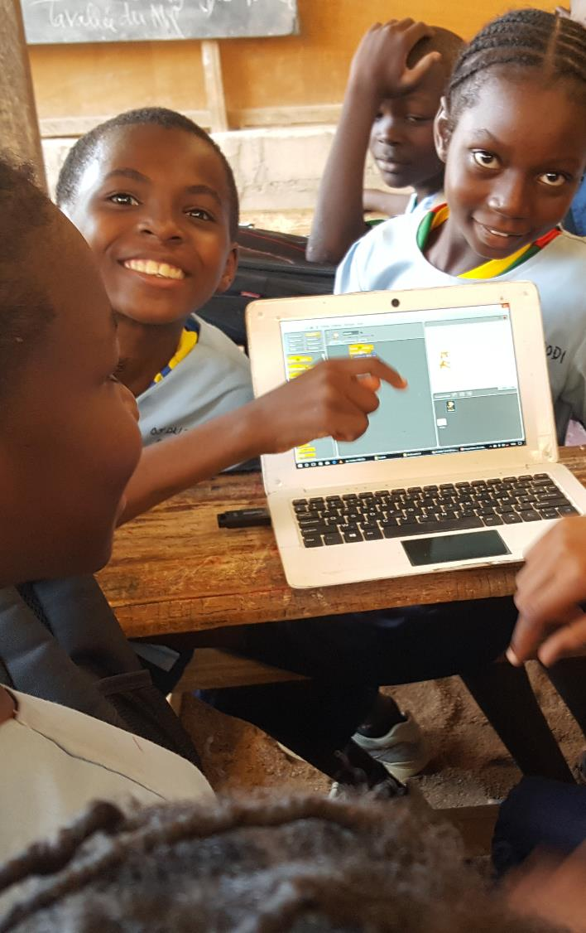
Looking for similarities, trends or patterns
It invites learners to analyse similar objects or experiences and identify commonalities. By finding what the objects or experiences have in common, young learners can begin to develop an understanding of trends and are therefore able to make predictions.
Pattern recognition
Your football team are playing your arch rivals this weekend. What tactics will you use?
What tactics worked well the last time you played them?
What tactics didn’t work so well against them?
Who are their best players?
Our striker is fast and skillful, but short. Should he cross the ball in high or play it on the ground?

Slide 16
Breaking big problems into smaller ones that are much easier to manage.
Analyze & look for a repeating sequence.
Decomposition
ABSTRACTION
Pattern recognition
ALGORITHM DESIGN
Remove parts of a problem that are unnecessary and make one solution work for multiple problems.
Step-by-step instructions on how to do something.

Slide 17
Focusing on what’s important, ignoring what is unnecessary.
Focusing on the information that is relevant and important involves separating core information from extraneous details.
Abstraction
You have been asked to draw a cat. Your image must be representative of all types of cats.
To draw a basic cat, we do need to know that it has a tail, fur and eyes. These characteristics are relevant. We don’t need to know what sound a cat makes or that it likes fish. These characteristics are irrelevant and can be filtered out.

Slide 18
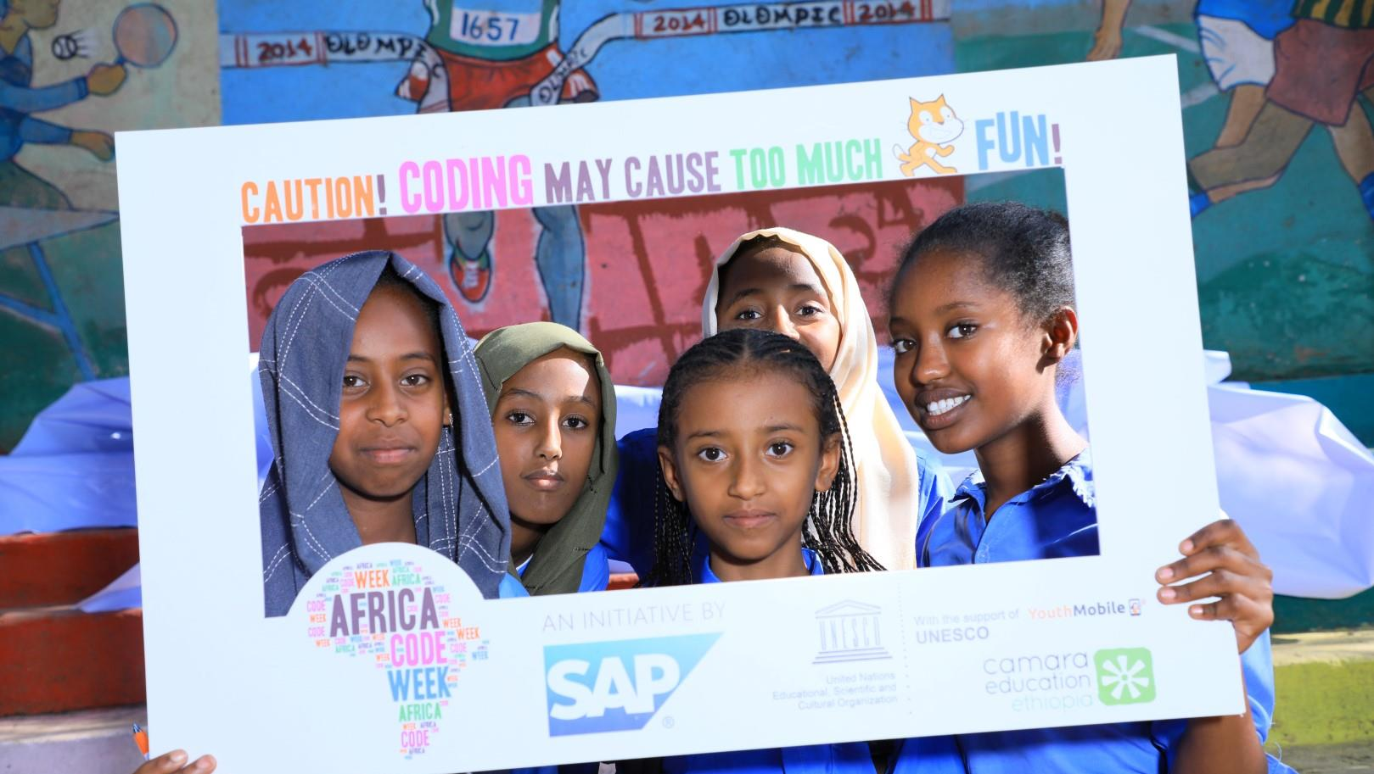
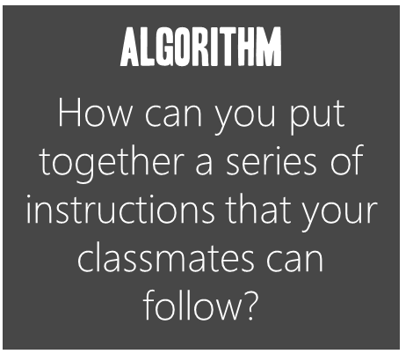
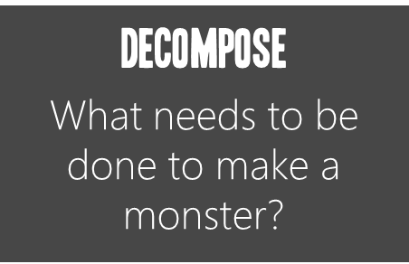
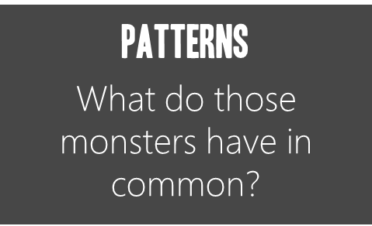
Group Activity: monsters
Algorithm
How can you put together a series of instructions that your classmates can follow?
Decompose
What needs to be done to make a monster?
Patterns
What do those monsters have in common?
Abstraction
What’s different? Take it out.
Notes:
The Master Instructor will ask the classroom to imagine, individually, what a monster looks like and then draw its head on a sheet of paper, without showing it to his or her neighbour.
After a few minutes, the Master Instructor will ask the classroom to split into groups of two and exchange their drawings.
Each group should discuss the similarities between their monsters (eyes, hair, face etc.).
The Master Instructor can share some drawings with the whole classroom and ask volunteers to share the similarities discussed.
Do the link with the three key concepts of computational thinking: decomposition, pattern recognition and abstraction.

Slide 19
Breaking big problems into smaller ones that are much easier to manage.
Analyze & look for a repeating sequence.
Decomposition
ABSTRACTION
Pattern recognition
ALGORITHM DESIGN
Remove parts of a problem that are unnecessary and make one solution work for multiple problems.
Step-by-step instructions on how to do something.

Slide 20
Create a set of step-by-step instructions to complete a task.
It involves developing a solution to a problem by creating sequential rules to follow in order to solve it.
Algorithm design
Someone stops you and asks for directions to the nearest store. You need to give them clear, step-by-step instructions to the quickest route.

Slide 21
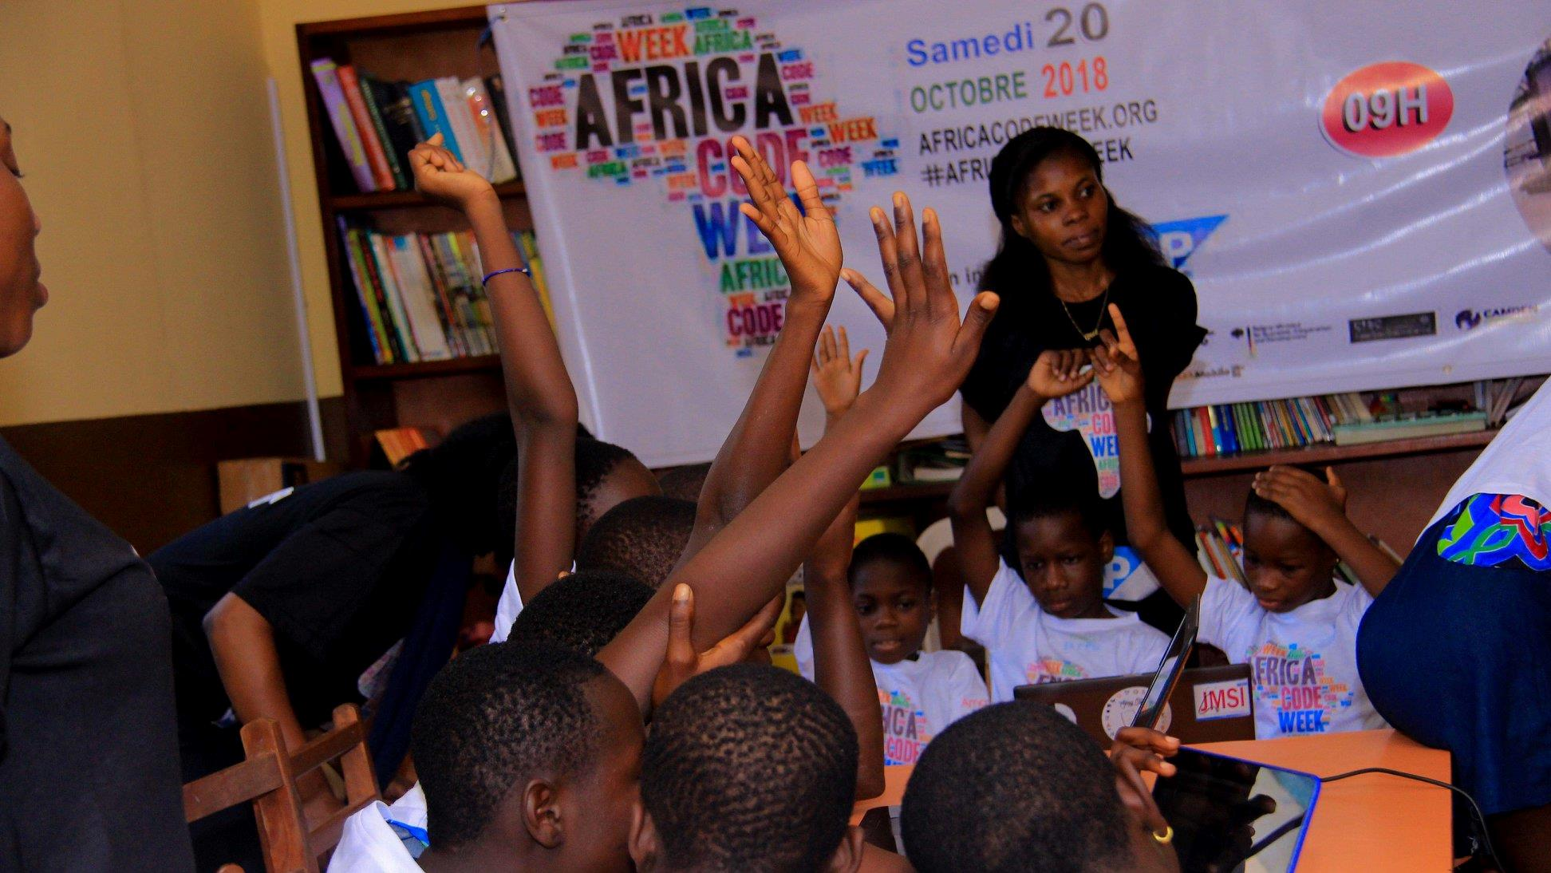
Group Activity
Step-by-step instructions
AN INITIATIVE BY
Notes:
The Master Instructor will ask its classroom to split into groups of two.
One person will have to draw an object, the one of his or her choice, without showing it to their partner.
Then he/she will have to guide their partner with detailed instructions so that they can reproduce it identically, or almost identically.
The person giving instructions should not look at the progress of their partner's drawing, or share their drawing.
Example: if the drawing is a house, he/she will not be able to tell their partner to draw a house, but he/she will have to give detailed instructions instead.
The Master Instructor may share some drawings with the classroom, and ask what difficulties were encountered while giving instructions or reproducing the drawn object.

Slide 22
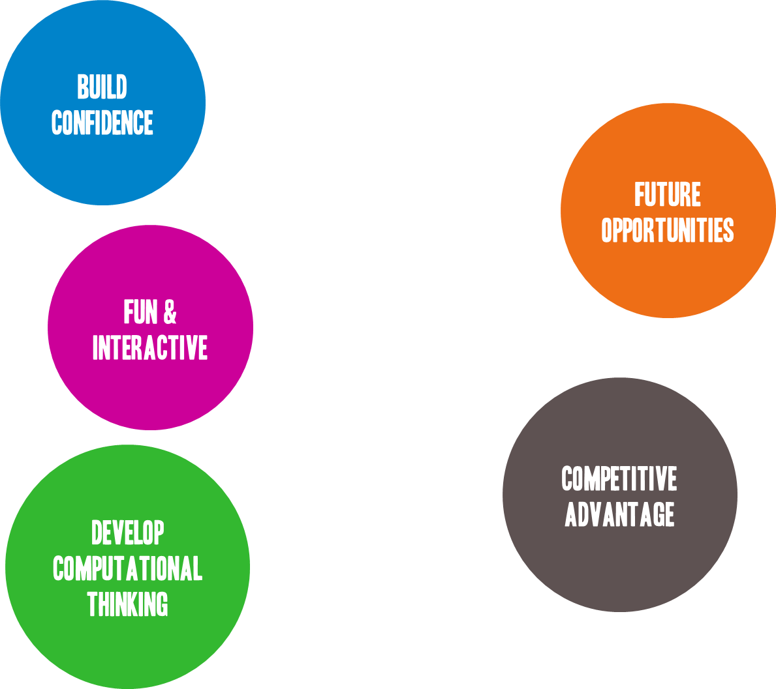
Build confidence
Digital skills...
Fostering creativity &
communications
Future opportunities
High demand for computational skills globally
Fun & Interactive
Fostering teamwork & collaboration
Competitive advantage
Develop computational thinking
Understanding and actively participating in the digital world around me
Building analytical skills, problem solving and logical thinking

Slide 23
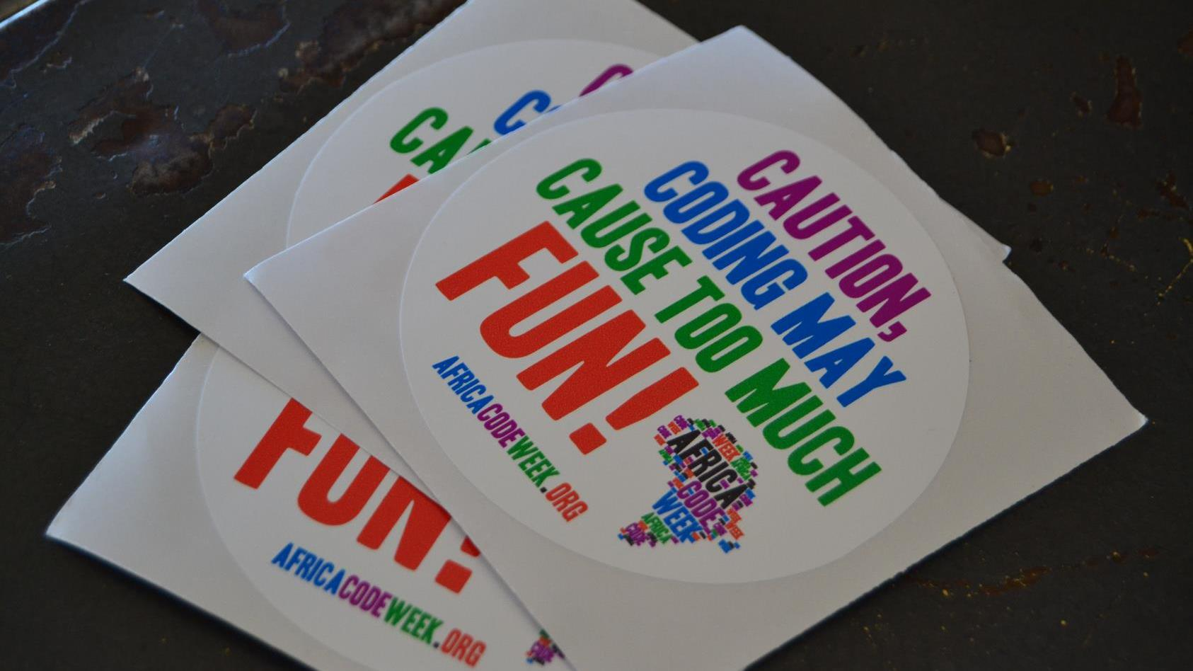
all in agreement
“Learning to code
…teaches you how to think.”
Steve Jobs
“Whether we're fighting climate change or going to space, everything is moved forward by computers, and we don't have enough people who can code.”
Richard Branson Virgin Group Founder
“All of my friends who have younger siblings who are going to college or high school - my number one piece of advice is: You should learn how to program.” Mark Zuckerberg
CEO, Facebook
…makes kids feel empowered, creative, and confident.”
Susan Wojcicki CEO, YouTube
…stretches your mind, and helps you think better, creates a way of thinking about things that is helpful in all domains.”
Bill Gates Chairman, Microsoft

Slide 24
Once you master the basis and start writing code, you can leverage this to start solving a variety of problems from virtually any other subject.
Learning in a meaningful context.
Learning is a process, not a product.
Simplifying complex ideas into simpler parts.
Collaborating with others.
Persevering in the face of frustration.
Taking risks.
Becoming tech-fluent helps them open up and express ideas.
Interacting with the world around them.
LANGUAGES
Statistical analysis of a corpus, vocabulary exams.
CHEMISTRY
Adapt chemical reactions, create valency & symbol tests.
PHYSICS
Use formulas, simulations.
Coding is a cross-curricular subject
Coding is a cross-curricular subject
SOCIAL STUDIES Apply statistical analysis to data sets.
MATHS Solve equations, calculate areas & volumes, explore fractals, calculate Pi’s decimals.
The Skills students learn from coding
BIOLOGY
Cell simulators, game of life, etc.
Eternal sunshine of a coder’s mind...
TECHNOLOGY
Artificial Intelligence systems, games.

Slide 25
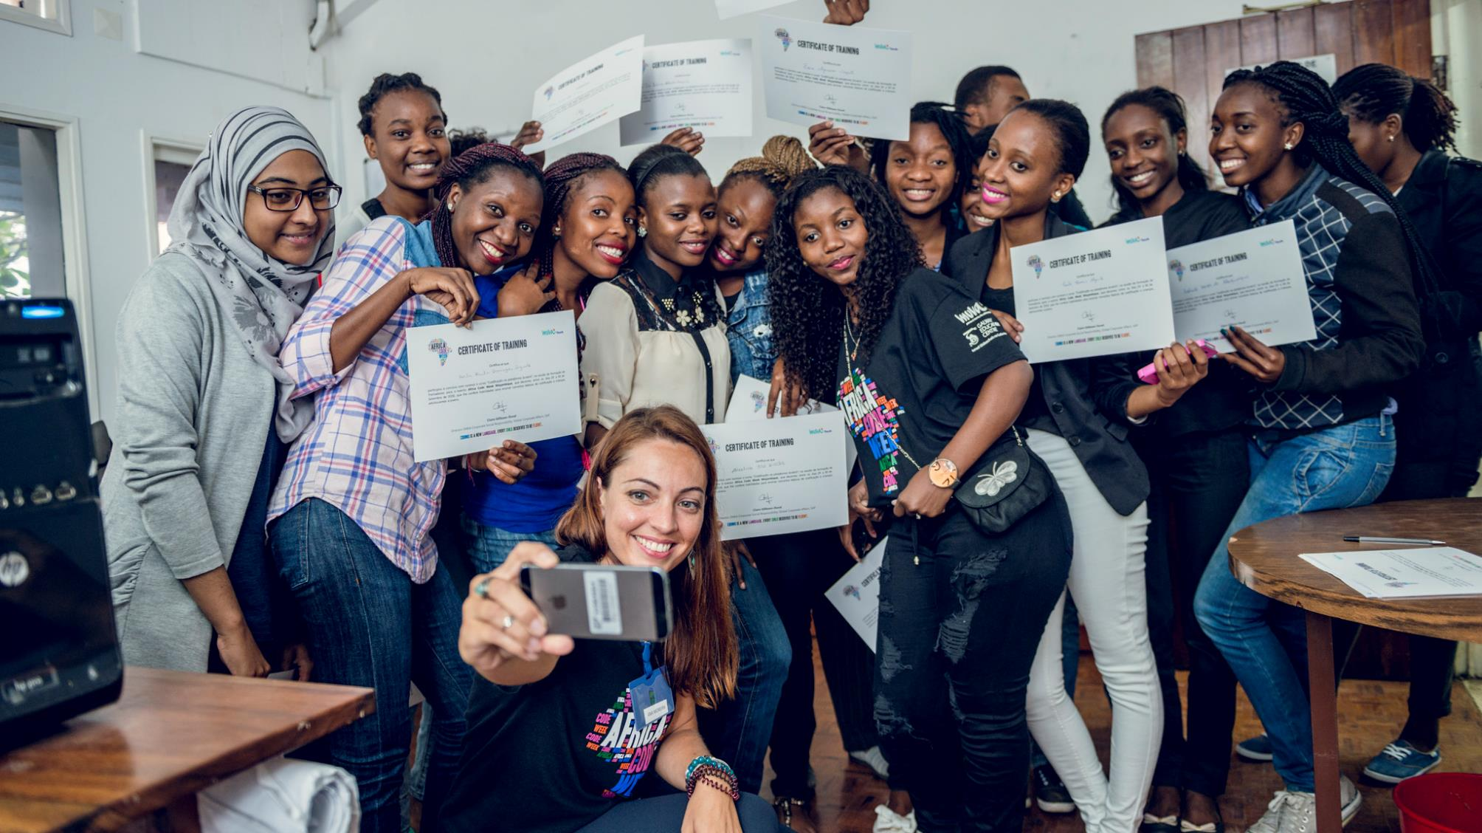
We need more women in higher education ICT studies
of women in ICT studies in higher education globally
Source: UNESCO Institute of Statistics database (2017)
Notes:
Integrated ICT in the teaching practice is important to build digital skills, enhancing teaching and learning, and to motivate children to take up future studies and careers that in ICT, considered to be critical for the jobs of the future.
One aspect of concern in many countries is the lower level of digital skills found among girls, and lower participation of girls in ICT studies in higher education.
In 2017, women accounted for just 28% of ICT graduates globally, a gender disparity without parallel in other disciplines, including traditionally male-dominated fields such as medicine and science. These rates are similar in Africa, dropping to only 4% in Ghana to 41% in Eritrea. As the World Economic Forum has pointed out, equipping a girl with even rudimentary ICT skills can make a difference in her future earnings when she grows up, with intergenerational benefits to her children’s education, health and well-being.

Slide 26
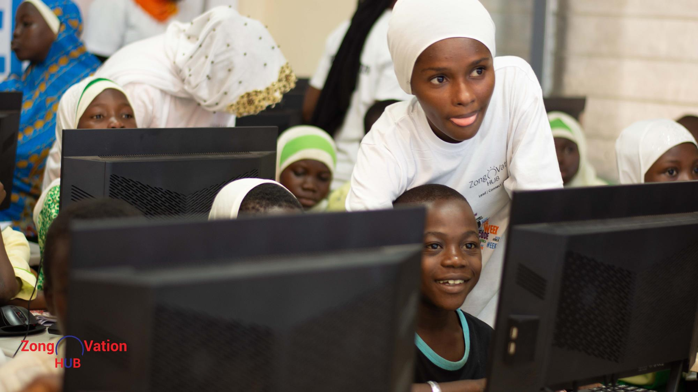
2. let’s PRACTICE WITH !
AN INITIATIVE BY

Slide 27
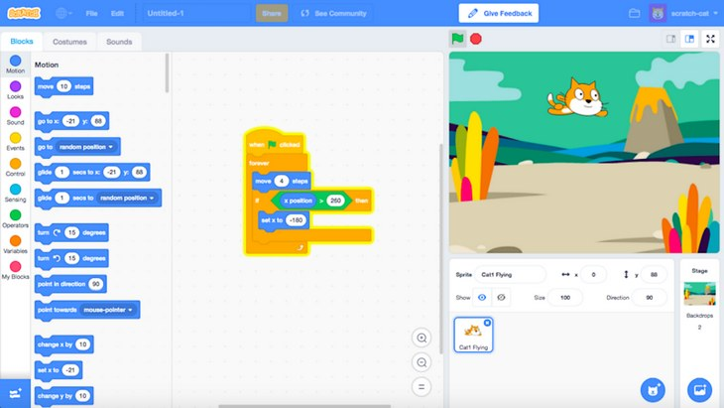
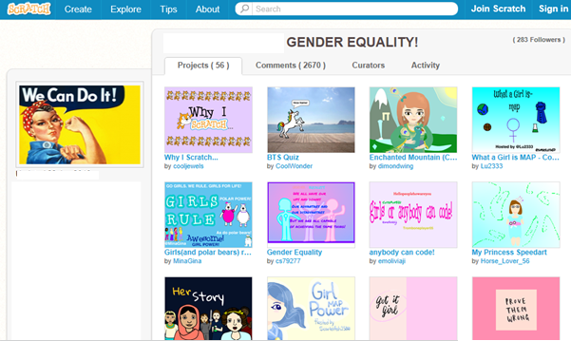
Computational thinking
What is ?
A very powerful programming language developed by the MIT Media Lab to simplify the face of coding form the young generation.
Based on a block-building approach, it uses a simple structure of visual bricks or blocks of computer code that snap and interlock together.
Can be used for a range of subjects across the school curriculum.
Fosters team work and communications by allowing students to create, share and download projects directly to/from the Scratch web site.
A Program is a set of instructions that tells a computer or other electronic device what to do. The script used is often referred to as ‘code’ or ‘computer code’.
Computer programing or coding is the process of writing code.

Slide 28
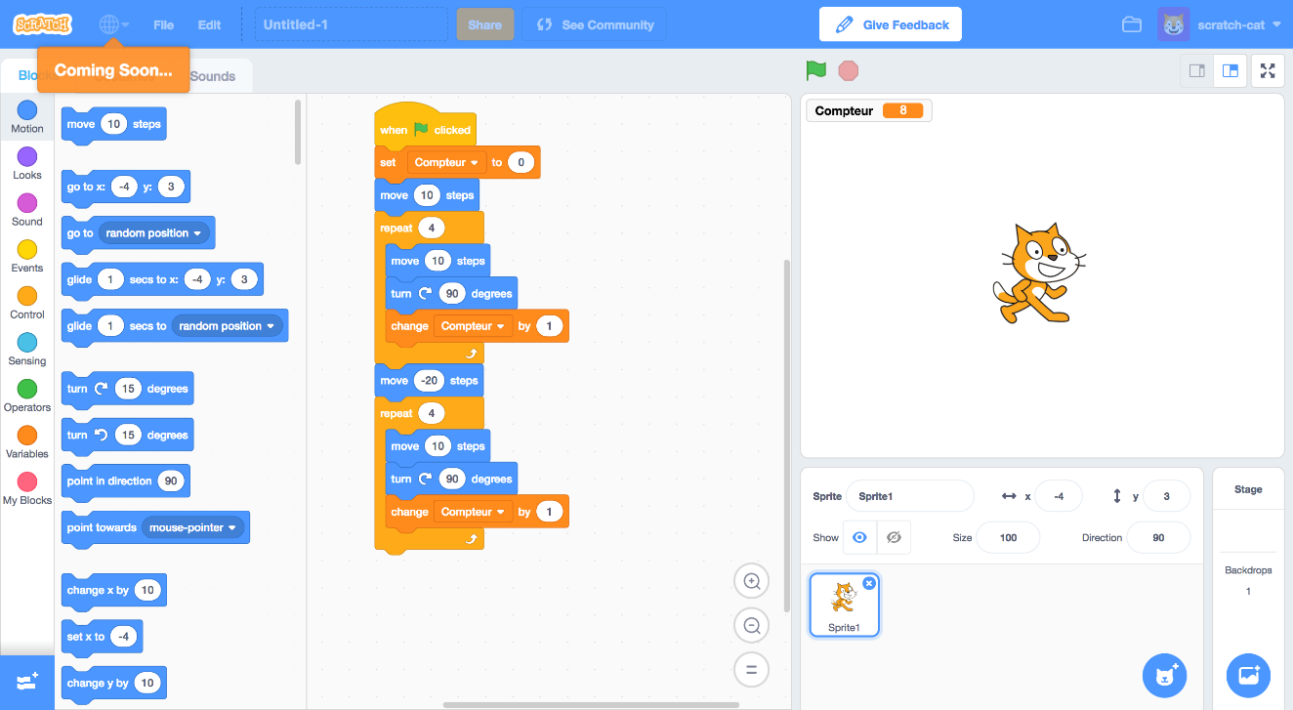
Let’s Practice
With !
Scratch 3
Open it and let’s get started!

Slide 29
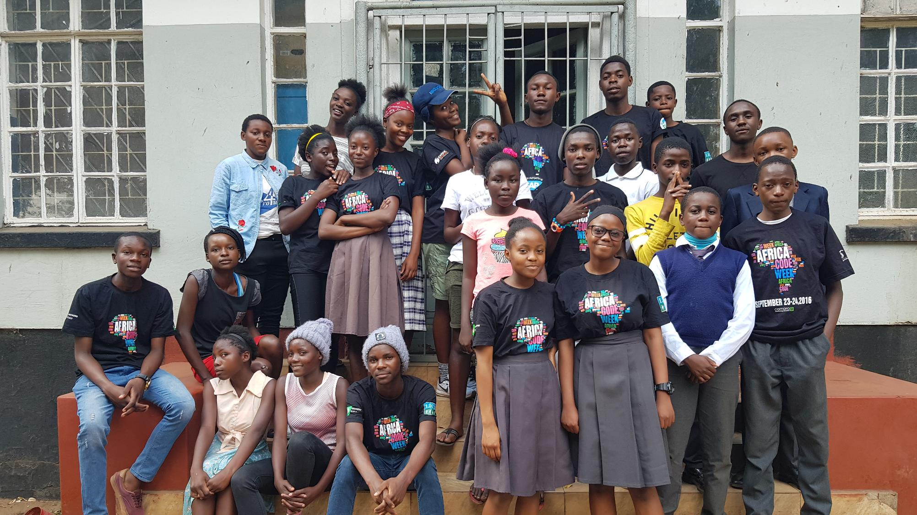
Additional resources...
AN INITIATIVE BY

Slide 30
Teaching Materials developed for Africa Code Week by our Master Instructor Brendan Smith
https://africacodeweek.org/media/resources/
Your end-to-end guide to the new Scratch 3.0 with 30 fun exercises to empower your students with coding skills.
A project-based Teaching Guide to shed a whole new, fun light on the school curriculum - from algebra and geometry all the way to wildlife and geography.

Slide 31
Girls Coding Camp | http://girlscoding.com.ng/codecamp.html
Female Role Models | https://www.madewithcode.com/mentors/
How should coding classes be designed to keep especially girls involved and engaged? | https://www.youtube.com/watch?v=QvyTEx1wyOY
A successful example of how learners use ICT for learning and knowledge construction | https://www.iamscienceproject.com/
Bridging the Gender Gap | https://technovationchallenge.org/get-started/
Video by Maria Klawe taking about creativity and engaging more girls in ICT classes | https://www.youtube.com/watch?v=ekFwwUcErFc
Cyber Bullying | https://studio.code.org/s/coursec-2018/stage/13/puzzle/1
EQUALS Skills Coalition Links

Slide 32
Explanation of computational thinking and its cornerstones: |  | https://www.youtube.com/watch?v=mUXo-S7gzds
Unplugged - Computational Thinking Lesson in action: | An overview and model for teachers which explains what computational thinking is using a practical example. | https://www.youtube.com/watch?time_continue=25&v=b4a7Ty1T pKU
 | Classified Monsters Instructions | https://studio.code.org/unplugged/unplug2.pdfactivity
 | Classified Monsters Video | https://studio.code.org/s/20-hour/stage/3/puzzle/1
Video Clips from Computational Thinking Lesson

Slide 33
https://www.sciencebuddies.org/teacher-resources/lesson- plans/junkbots
https://igamemom.com/kids-activities-learn-coding-without-computer/
http://www.science-sparks.com/coding-kids/
https://www.youtube.com/watch?v=xkZi6QuW7UI
http://www.scienceinschool.org/content/coding-without-computers
http://girlscoding.com.ng/codecamp.html
coding without a computer

Slide 34
http://www.allyouneediscode.eu/lesson-plans
http://www.computationinitiative.org/resources/teaching/
https://edu.sphero.com/cwists/category
http://scratch.ie/resources
https://education.minecraft.net/class-resources/lessons/
https://csfirst.withgoogle.com/c/cs-first/en/curriculum.html
https://csfirst.withgoogle.com/c/cs-first/en/high-seas-activity/overview.html
https://code.org/curriculum/course3/1/Teacher
coding lesson plans

Slide 35
https://www.commonsense.org/education/teaching- strategies/get-started-with-coding-in-the-classroom
http://www.theedadvocate.org/9-tips-teaching-coding-classroom/
https://code.org/educate/resources/videos
http://blogs.edweek.org/edweek/education_futures/2017/06/9_tips_for_teaching_coding_in_the_classroom.html
coding lesson plans
Tips for teachers

Slide 36
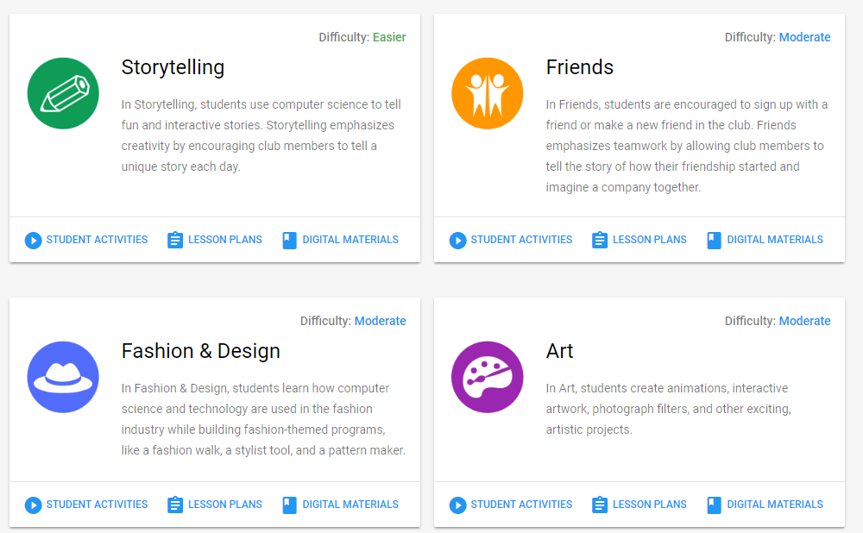
https://csfirst.withgoogle.com/c/cs-first/en/curriculum.html
Explore this link for news ways to apply computational thinking to real-life problem solving:

Slide 37
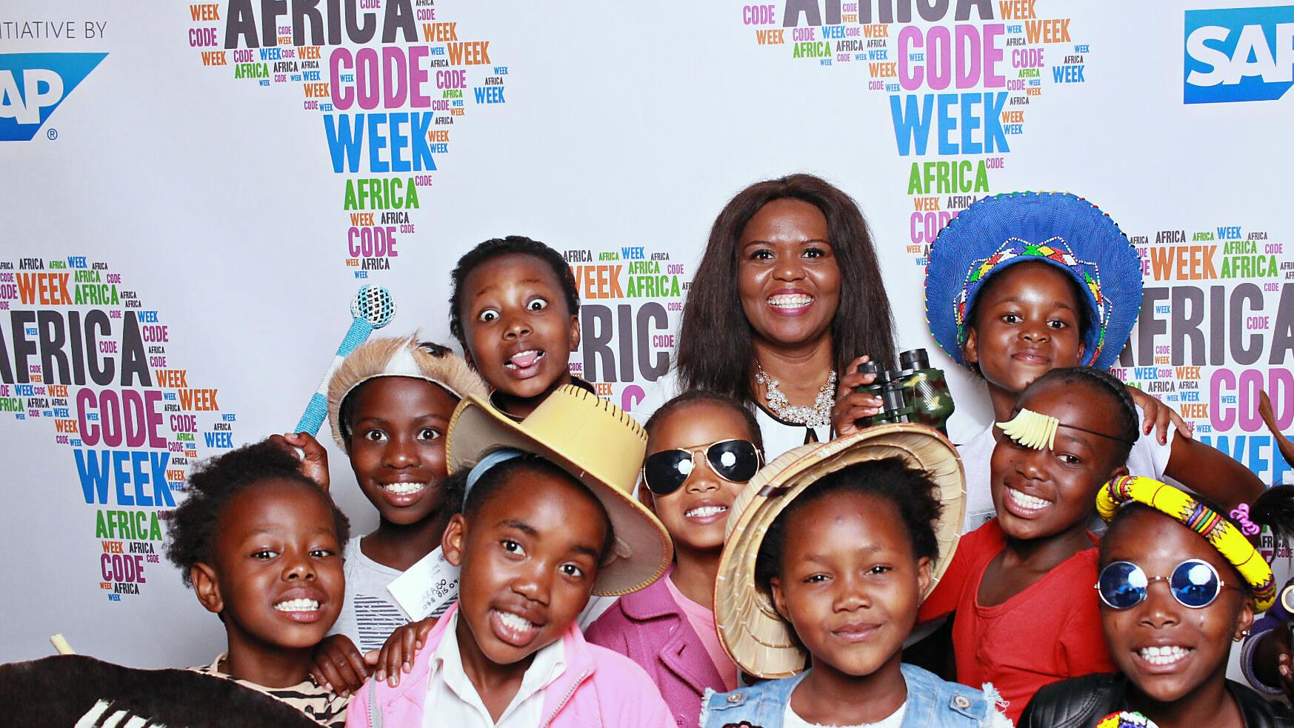
Join our fast-growing community of more than 50,000 fans
#africacodeweek
@africacodeweek
@sap4good
/africacodeweek
/sap4good
/africa_code_week/
Africa Code Week

Slide 38
Thank you!
AN INITIATIVE BY

Slide 39
AN INITIATIVE BY

