Slide 1
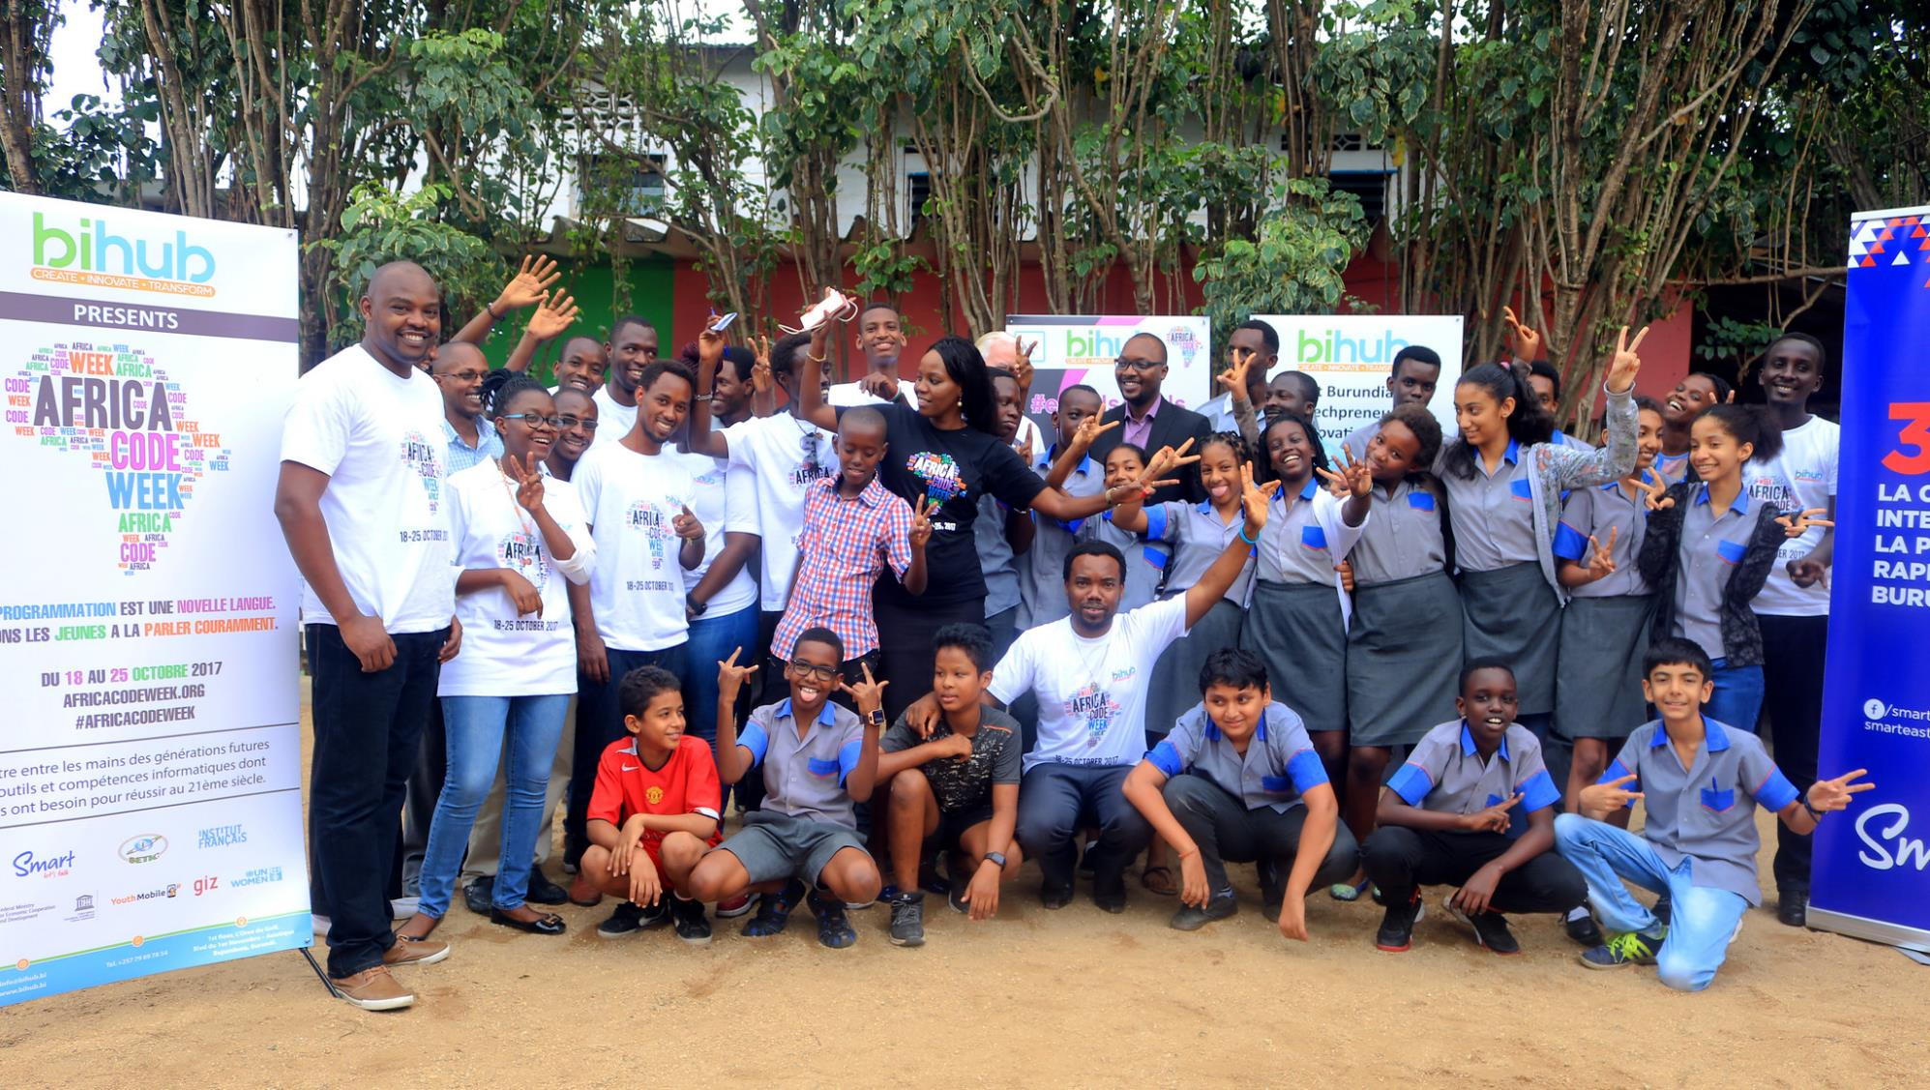
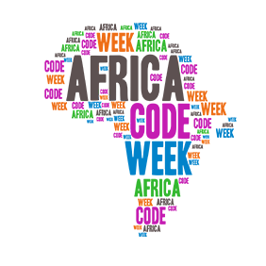
An initative by
Working closely with private, public and non-profit partners to drive sustainable learning impact across Africa, instilling digital literacy and coding skills in the young generation.
in collaboration with:
What’s new in 2018?
Engaging 600,000 youth across 36 countries
October is still Africa Code Week month! This year, each country gets to choose their own 1- or 2-week October time frame.
New digital learning curriculum to increase understanding of computational thinking, coding proficiency, enabling technologies & data analytics.
1.8 million
young Africans introduced to coding skills since 2015:
25,000
5,000
35
46.5%
5
150
participating countries
teachers trained
coding workshops for 8-16 year-olds
average girl participation
partners across Africa
international awards

